Slide 1
File Management
Chapter 12
Last Updated 4/16/2018 1:31 PM

Slide 2
Files and File Systems
Creating, maintaining, and organizing files is one of the most visible and important services provided by operating systems.
A File System provides these capabilities to its users…
Persistent, long-term storage of potentially large amounts of data as streams of bytes.
An API used by applications to create and access the file data.
Methods of protecting the file data from unauthorized access.
Methods of organizing files.
Organizing files into groups (directories).
Allowing the user to search for needed files among many files and directories.

Slide 3
A File System is an OS Service
A file system is an organization of data structures that built on the data blocks maintained by the drive.
Persistent data structures that survive system power downs.
Drives can be HDD, SSD, USB Drives, DVD, etc.
A terabyte drive maintains almost 270 million 4K-byte blocks.
A File System is an operating system service that maintains and organizes persistent data on this large number of blocks.
Creating and maintaining file system objects (files, directories, etc.).
Notes:
An 8TB drive maintains > 2 billion blocks.

Slide 4
File System Operations
The operating system provides an API of standardized file system operations (syscalls):
Note that function of these operations is independent of the instance of a file system or the type of file system.
Linux: EXT3, EXT4, NTFS, FAT, and many other file systems are all accessed using the same programming API.
Create New File (open) | Delete File (remove)
Open Existing File (open) | Close File (close)
Read Data From File (read) | Write Data To File (write)
Seek Within File (lseek) | Truncate (Clear) File Data (truncate)
Create Directory (opendir) | File Status (fstat)

Slide 5
A File’s Structure
Logically, a file is a sequence of bytes that can be written to, read from, and extended with additional data.
File system APIs present a file’s contents as a stream.
Abstractions like Input and Output Stream allows programs to read and write bytes to a file.
Physically, a file’s contents (data) is recorded across a number of assigned drive blocks.

Slide 6
Manipulating a File’s Contents
It is not possible to insert or remove bytes midstream.
For example, inserting a record mid-file require explicitly making a hole by copying downstream bytes.
It is possible to move the position of the next IO operation to a byte offset within the file using the ‘lseek()’ API.
The open file descriptor maintains a pointer where the next read or write occurs.
It is possible to decrease or increase the length (size) of a file using the truncate() API.
An extended file is filled with zeros.
Notes:
Although it is possible to overwrite some range of data within the file with new data.
How to remove a record from a file? Need to copy data over record and ftruncate() the file to adjust it to its new length (minus record).

Slide 7
File System Operations
The File System uniquely identifies every file it contains.
This is typically the file’s full path (from root directory to file).
And across file systems e.g. HTTP access to remote file systems.
The FS maintains ownership, permissions, and other attributes that controls who has what access to a file’s contents.
Notes:
Originally, HTTP servers were file servers providing access to the HTML, images, css, and other files that made up a web site. Later, the idea of CGI was developed which attached executable programs to specific locations in the site.

Slide 8
File Descriptors
A File Descriptor is an object that represents an open file.
Created when a file is first created or subsequently opened.
File descriptors are system resources managed by the operating system / file system.
Every process is associated with a list of its open file descriptors maintained in the Process Control Block.
The File Descriptor maintains the state of the process’s ongoing interaction with the file.
The FD maintains the stream index of the next I/O operation.

Slide 9
File Descriptors
File Descriptors are handles returned by the create or open API calls and are used to access a file.
The open(name) returns an index into the process’s FD table.
The syscalls return an index to the FD in the kernel.
int creat(const char *pathname, mode_t mode);
int open(const char *pathname, int flags);
File operation syscall require an open File Descriptor.
The read( fd, buff*, n) attempts to read n bytes into buff from the file referenced by the file descriptor (fd).
Notes:
Why does the open() syscall return an index into a table and not a pointer to file descriptor data structure. Because the descriptor is maintained in kernel space.
Stdin, stdout, and stderr are three file descriptor automatically assigned to every process in Unix & Windows.

Slide 10
File Systems
File Systems are operating system services responsible for maintaining persistent data on the system’s storage devices.
HDD, SSD, USB Drives, CD, etc.
A File System maintains persistent data structures that organize the blocks provided by a drive.
File Allocation Tables (FAT) is the generic name for this structure.
The OS provides utility commands that allow the user to create, explore, and manipulate the file system and its contents.
The OS conforms to a standard API that allows a program create and manipulate a contents of the file system.
Notes:
Linux: The utility MKFS (Make File System) is used to create a new file system on a target drive partition.
Linux: mkdir, touch, cat, ls, and other command-line utilities allow the user to manipulate a file system.

Slide 11
File Systems
There are several vendors / types of file systems that provide varying degrees of performance, reliability, security, etc.
Windows: NTFS, FAT, and HPFS.
Linux: EXT2, EXT3, EXT4, FAT, and about 30 others.
Wikipedia entry for supported Linux file systems.
What are the differences between Linux File Systems?
A system can maintain multiple drives, each with multiple partitions containing it own unique file system.
Partitions can maintain different FS types i.e. FAT and NTFS.
It is possible to partition a drive with both Windows and Linux file systems.
Notes:
The implications are that file systems are ‘pluggable’ modules in operating systems. As shown above, the Linux kernel has support for dozens of file system types.
Ext2(1993), Ext3(2001) introduced journaling, Ext4(2008) increases in FS and file sizes.

Slide 12
File System Objectives
Meet the data management needs of the user.
Persisting their data safely and efficiently.
Guarantee that the data written to the file system is safely maintained.
Minimize the potential for data loss in the event of a system crash.
Provide a standard file I/O API that works against all supported file system types.
Provide the operations mentioned earlier.

Slide 13
File System Objectives
Provide I/O support for a variety of storage device types.
SATA Drives, USB Drives, SCSI, CD-ROM, Network Attached Storage (NAS) are all accessed with the same file API.
Optimize performance of I/O devices e.g. increase disk utilization.
Secure the access to files and other FS objects to authorized users.
File ownership and access permissions.

Slide 14
File System Objectives
Provide I/O support for safe access to the file system by multiple Processes / Threads.
Multiple processes share access to a file system creating the potential for race conditions in the code implementing the FS.
FS are design to assure that concurrent access by multiple processes does not result in the file system’s corruption.
Allowing files, and even byte ranges in a file, to be locked preventing multiple processes from writing simultaneously.
File Locking is supported by most file systems.

Slide 15
A File System’s Structure
A file system’s data structures (FAT and UBL) are maintained in disk blocks on its partition.
A file system’s capacity is determined by the number of blocks maintained by the partition used to host the FS.
A newly created file system is initially an empty directory in which new files and directories can be created.

Slide 16
Root and Child File Systems (Unix)
Every system maintains a single root file system that contains the operating system’s executables, libraries, data files, etc.
The root FS is mounted when the OS boots.
Separate file systems are created to maintain data other than the operating system.
It is common to use a separate file system to maintain the user’s home directories.
All non-root file systems are mounted as children of the root.
Child file systems are mounted within the root file system.
The location in the root FS where a child FS is attached is called a mount point.

Slide 17
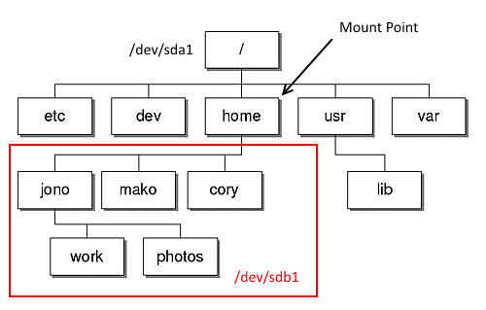
A System Maintaining Two File Systems (Unix) / (root) and /home file systems
The root file system (/) is maintain on partition /dev/sda1.
The home file system is maintain on partition /dev/sdb1 and has been mounted as a child FS under the root at /home.
Notes:
mount /dev/sdb1 /home
sda & sdb are separate drives (devices).

Slide 18
Creating and Mounting File Systems
The OS provides a number of command utilities that are used by administrators to create and mount file systems.
Mounting a file system makes it available to the OS and its users.
Linux MKFS command creates a file system on a disk partition.
mkfs –t ext4 /dev/sdb1
Linux MOUNT command mounts a file system (partition) at a mount-point directory.
mount /dev/sdb1 /home This command will make the FS previously created on sda1 available in the /home directory.
Notes:
The file /etc/fstab contains the default partitions and mount points to be established when the system boots.

Slide 19
Root and Child File Systems (Windows)
Typically, Windows file systems are not nested.
Each file systems is presented as a volume (C:, D:, etc.)
The volume is needed to specific the full path to a file.
However, Windows does provide support for nesting filesystems.
A child directory (folder) on a volume can be mounted as folder in a separate parent volume.
See “Mounted Folders”.

Slide 20
Layered I/O Architecture
Applications
User Space
Kernel Space
I/O System Calls (API)
File System
I/O Supervisor
(Disk Block Management)
Device Drivers
Device Controllers
Physical Devices
Notes:
Discuss Linux Storage Stack Diagram.png here.

Slide 21
I/O System Calls Layer
Implements the generic OS system calls used to create / open / read / write / seek / close files.
Maps these generic operations to File System Type specific operations provided by the File System Layer.
Services that provide the process the view of the file as a stream of bytes; read & write operations.
Manages the allocation and maintenance of File Descriptors.

Slide 22
File System Layer
Implements File System services and data structures.
Maintains and manages the persistent data structures used to maintain the file system.
File Allocation Table
Unallocated Block Lists
Enforces user-based ownership and file system security.
Provides support for multiple file systems (partitions) and file system types (NTFS and FAT).

Slide 23
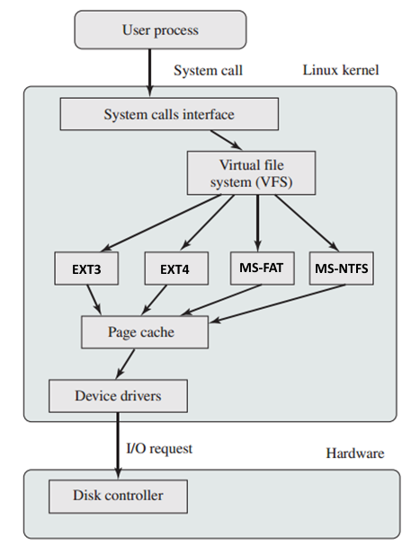
Linux Virtual File System
Notes:
Linux supports many file systems in a modular, decoupled architecture.
Each FS module maintains the file system’s FAT and free block list of an attached file system.

Slide 24
Basic I/O Supervisor Layer
Responsible for scheduling block-oriented disk access to optimize system performance.
Covered in Section 11.
Maintains the data structures used to manage I/O devices and schedule I/O operations.
Performs I/O block operation scheduling.
Queues I/O block requests for each block (disk) device.
Maintains and Caches Disk Blocks in buffers maintained in kernel memory.

Slide 25
File System Directories
The directory is an abstraction found in every file system.
The directory maintains information about the files it contains.
The mapping between a name (string) and a data structures maintained by a file system.
The size of the file.
The ID of the file’s owner and owning groups.
Date created, date last updated, and date last read.
In Linux, the Directory is implemented as a special file that is protected from direct modification by user programs.

Slide 26
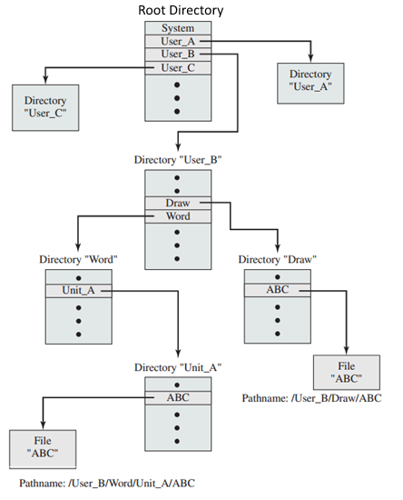
Directories are Maintain Hierarchically
Directories are organized as a tree.
Directories at the root and every non-leaf node in the structure.
Leaf nodes are normally files, but could be empty directories.

Slide 27
Hierarchical File Naming
A file or directory’s name must be unique in its directory.
It follows that the path from the root directory to a file or directory must also be unique.

Slide 28
File Sharing
When the file system can be accessed by multiple users there are two issues:
Management of Simultaneous Access
Managed like critical sections, a file is a shared resource that requires controlled access through ownership and locking.
Access Rights
Controlling the specific access a user, or group of users, has to a file.
Notes:
NTFS: Access control is one of the file’s properties.
EXT: Access control is optional and implemented by locks created by specific system calls.
https://en.wikipedia.org/wiki/File_locking

Slide 29
Simultaneous Access: Windows
It is possible for two processes to concurrently read and write to the same file.
Although this practice is discouraged and may corrupt the data stored in the file.
In Windows, a file owners can specify the amount of concurrency allowed on the file e.g. exclusive, multiple readers, etc.
Individual users and user groups can be given specific permissions on individual files.
Even ranges of bytes (records) within a file can be locked.

Slide 30
Simultaneous Access: Linux
Access permissions can be controlled on the owning user and granted to selected users and user groups.
Not as flexible (or complicated) as Windows.
The API SYSCALL fcntl(2) provides a single generic service call that is used to manipulate files.
Including locking the file or ranges of bytes within the file.
Notes:
Linux advisory locking requires cooperating processes to play fair and acquire the file’s lock before accessing the file’s contents.

Slide 31
Linux File Locking
File locking can be voluntary (advisory) or mandatory.
Advisory locking requires that processes cooperate when locking.
Mandatory locking is enforced by the OS but increases overhead.
Linux user command flock(1) allows users to place shared (read) and exclusive (write) access locks on files from within shells.

Slide 32
Assigning Access Rights Access rights are granted based on user attributes
Owner
Each file has only a single owner.
Usually the user that created the file.
Has as full access rights and may grant rights to others.
Specific Users
Specific users granted specific rights based on their user ID.
Not supported by Unix / Linux systems.
User Groups
A set of users can be made members of a group.
Unix / Linux can assign permissions to only a single group.
NTFS can assign permissions to multiple users, groups, computers.
All (Public)
Any user that has access to the system.

Slide 33
Storage (Block) Management
The file system is responsible for assigning blocks to files.
Recall a drive partition is made-up of N separately addressable blocks.
To manage block allocation, the file system must keep track of:
Which of the partition blocks are allocated to a file or directory (file allocation).
Which blocks are currently free or unallocated to any file (free space management).

Slide 34
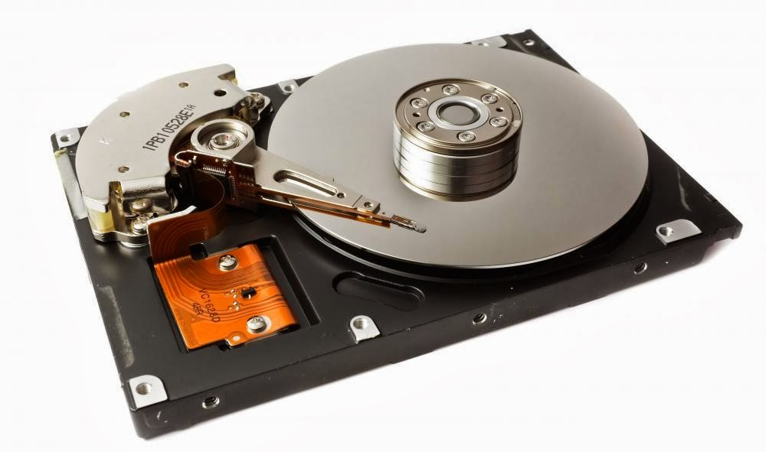

Hard Disk Drives (HDD)
The physical design places constraints on how to efficiently data is written to or read from the magnetic media.
Platters / Heads / Tracks / Sectors / Cylinders
Notes:
https://www.youtube.com/watch?v=4iaxOUYalJU
https://www.youtube.com/watch?v=Cj8-WNjaGuM
https://www.youtube.com/watch?v=rREkzeoJz1s

Slide 35
File Allocation Table (FAT)
The File Allocation Table is the data structure that records the files maintained by the file system.
The file’s name.
The blocks allocated to the file and the order in which they were recorded.
Depending on the file system, the FAT may maintain the owner, groups, timestamps, and other information describing the file that we described as maintained by a directory entry.
The FAT data structure is both cached in kernel memory and persisted on disk blocks.

Slide 36
Extents: The Unit of Disk Block Allocation
An Extent is a contiguous set of disk blocks allocated to a file.
Note: The book uses the term Portion to describe the same concept, but Extent is the far more common term.
Extents can range in size from a single block to the blocks needed to contain the entire file.
A File’s Extents are maintained in the FAT.
In most cases, a file is composed of several extents.
Allocating a file in fewest extents is a desired property of a file allocation strategy.
Contiguous blocks can be read/written efficiently from the HDD.
Notes:
On HDD (not SSD), contiguous blocks tend to lie on adjacent sectors on the same track making their retrieval orders of magnitude more efficient to retrieve than blocks located across many tracks.

Slide 37
Extents Continued
A file made up of many small extents increases the overhead of accessing the files blocks in terms of disk access time.
Result is poor disk utilization if a file’s blocks are spread across the drive.
A file made up of many small extents increases the overhead of managing files i.e. increases the size of the FAT.
Increases Disk Fragmentation.
Disk Fragmentation is a metric describing the state of the file system.
A file system is fragmented if most of its files span many extents.

Slide 38
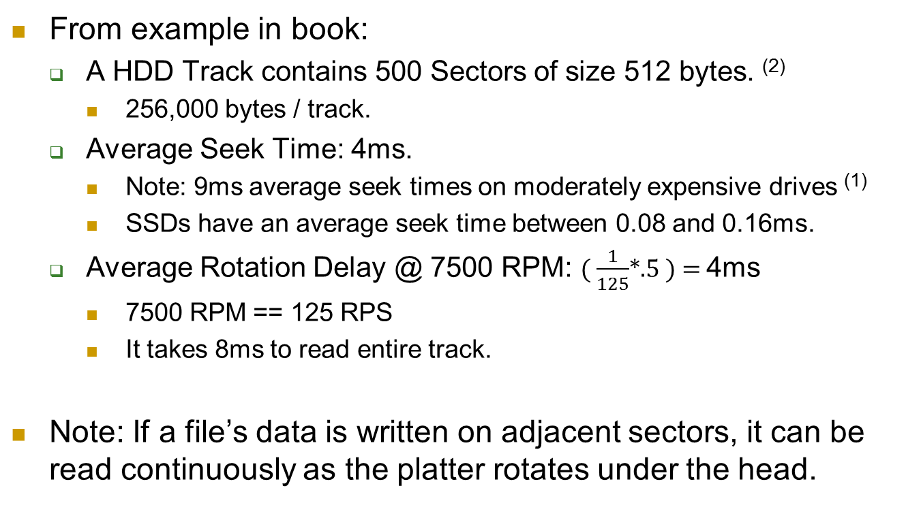
Effects of Extents on HDD Access Time
From example in book:
A HDD Track contains 500 Sectors of size 512 bytes. ⁽²⁾
256,000 bytes / track.
Average Seek Time: 4ms.
Note: 9ms average seek times on moderately expensive drives ⁽¹⁾
SSDs have an average seek time between 0.08 and 0.16ms.
Average Rotation Delay @ 7500 RPM: ( $\frac{1}{125}$*.5 ) = 4ms
7500 RPM == 125 RPS
It takes 8ms to read entire track.
Note: If a file’s data is written on adjacent sectors, it can be read continuously as the platter rotates under the head.
Notes:
Average seek time ranges from under 4 ms for high-end server drives, to 15 ms for mobile drives, with the most common laptop drives at about 12 ms and the most common desktop drives typically being around 9 ms. See: http://en.wikipedia.org/wiki/Hard_disk_drive_performance_characteristics
Note that modern disk drives have a sector (block) size of 4096.

Slide 39
Access Times Compared How much time is needed to read a 1.28mB file or 2500 sectors?
Single Extent: The file is written to adjacent blocks across 5 tracks.
16ms to read first block and 12ms to read each additional block.
Time to read file: 16 + (4 * 12) = 64ms or 0.064 Seconds. ⁽¹⁾
One Block Extents: The file is written across 2500 random blocks i.e. The drive must perform 2500 seeks.
Time to read one block: (4 + 4 + 0.016) = 8.016ms.
Time to read 2500 blocks: 2500 * 8.016 = 20.04 Seconds. ⁽²⁾
Extent sizes can be very important in optimizing Hard Disk Drive performance.
Notes:
(1) 4ms seek + 4ms rotational-delay + 8 track-read-time = 16ms for first track.
4 rotational-delay + 8 track-read-time = 12ms as the 2^{ed}, 3rd, 4th tracks have no seek time. = 48 ms
(2) 4 seek + 4 rotational delay + sector read time = 8.016ms / Sector
2500 * 8.016 = 20.04 Seconds for entire file

Slide 40
Preallocation Vs. Dynamic Block Allocation
Dynamic Allocation: Blocks are added to the file (its size is extended) as required by the application.
The file system allocates and records new blocks as the file grows in size.
Preallocation: The file system allows allocating all of the file’s blocks when the file is created.
The file’s initial size is specified when the file is created or resized e.g. Linux: fallocate() API.
Knowing the file’s size allows the file system to identify and allocate a single extent to the file.

Slide 41
Issues in File Allocation Methods
The size and complexity of maintaining the FAT data structure containing the blocks allocated to a file.
How much kernel memory and processor overhead is required?
How efficient is it to retrieve and visit all the blocks of a file?
The number of disk blocks used to maintain the FAT is not an important issue.
The size and efficiency of maintaining the data structure used to manage unallocated disk blocks.
How much memory and processor overhead?
How efficient is it to locate unallocated disk blocks?
How well does the method facilitate identifying and maintaining large numbers of unallocated blocks?

Slide 42
File Allocation Methods
The following File Allocation Methods are concerned with how the blocks allocated to a file are recorded.
Which blocks belong to the file and in which order are they recorded?
Contiguous Allocation: Files are allocated in a single extent of contiguous blocks.
Chained Allocation: Each block maintains a link to the following block (i.e. in a linked-list).
Indexed Allocation: A file’s blocks are maintained in special files called inodes.

Slide 43
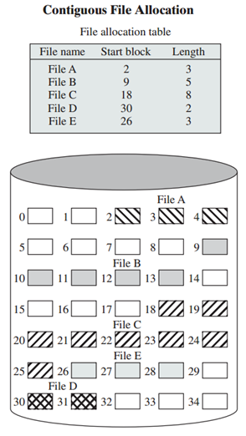
Contiguous File Allocation
Each file is recorded with its starting block and the number of blocks.
A very simple FAT structure.
Very fast transversal of the file’s contents.
Requires preallocation to work efficiently.
Difficult to extend the file.
Extending a file requires moving the file from its current extent to another larger extent.
Difficult to manage free space.
Creates external fragmentation.
Requires complex placement strategy i.e. best-fit, first-fit, next-fit.
Notes:
Another thing to note is that all the data needed to identify and transverse the file’s blocks are maintained in the FAT.

Slide 44
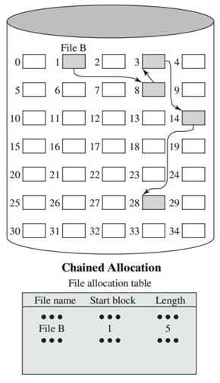
Chained Allocation
The file’s blocks are maintained as a chain of linked blocks i.e. a linked-list of blocks.
Each block maintains the block address of the next block in the file’s chain.
Simple FAT structure.
Simple single block allocation strategy.
Can results in small extents and inefficient sequential retrieval.
Embeds file system data into disk blocks.
Size of data contained in a disk block is not an even power of 2.

Slide 45
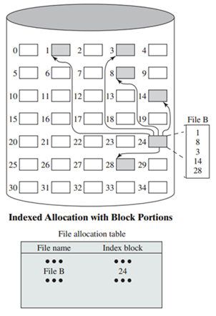
Indexed Allocation With INODES
An Index Block is dedicated to maintaining a list of the blocks allocated to the file.
In Unix file systems these index blocks are called inodes (index nodes).
The FAT references the inode blocks.
Simple single block allocation strategy for most (short) files.
Multiple inode blocks (lists or trees) can be chained together for large files.
Has a complex FAT / Index structure.
FAT and inode blocks are cached in memory.
Notes:
This is the classic UNIX method.

Slide 46
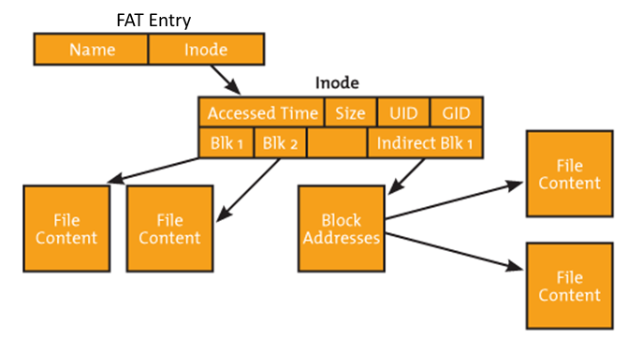
Simplified Linux INODE Structure
Data blocks are maintained in a hierarchical data structure.
The root INODE maintains the file’s metadata (size, times, etc).

Slide 47
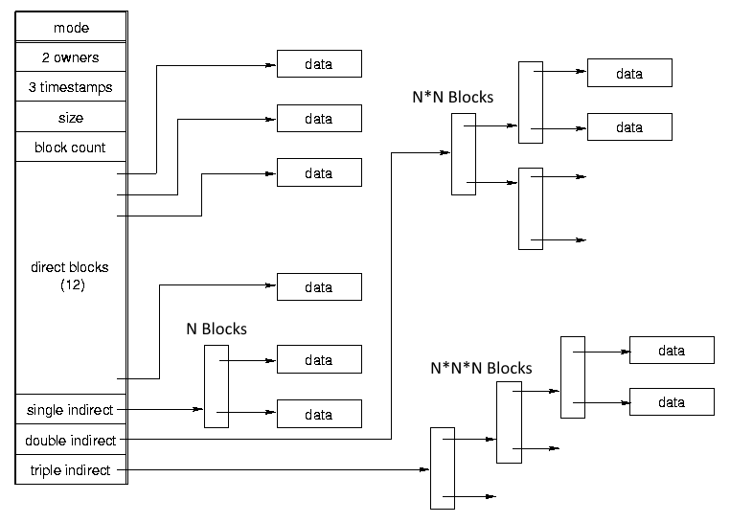
Linux Nested Block Structure
Notes:
Linux EXT4 can maintain files of up to one exbibyte, but a max size of 16 terabytes is recommended.
1 exbibyte = 2⁶⁰ bytes = 1152921504606846976 bytes = 1024 pebibytes

Slide 48
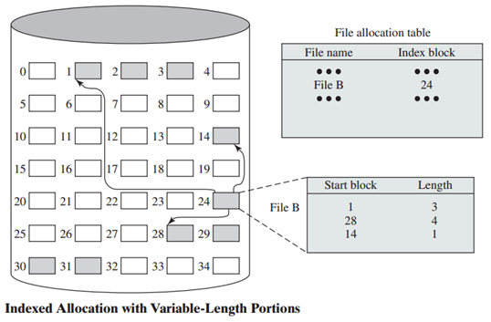
Indexed Allocation with Variable-Length Extents
Inode blocks maintains a list of variable length extents.
Further complicates FAT / Index Block / etc.
Allows for faster sequential access when contiguous blocks can be allocated to a file.
Notes:
Inode entries maintain the starting block, and length of each of the file’s extent.

Slide 49
Free Space Management
Keeping track of, and allocating unused disk blocks.
Unallocated blocks are maintained in a Disk Allocation Table.
Free Space Management Strategies include:
Bit Tables
Chained Free Extents
Free Block Lists

Slide 50
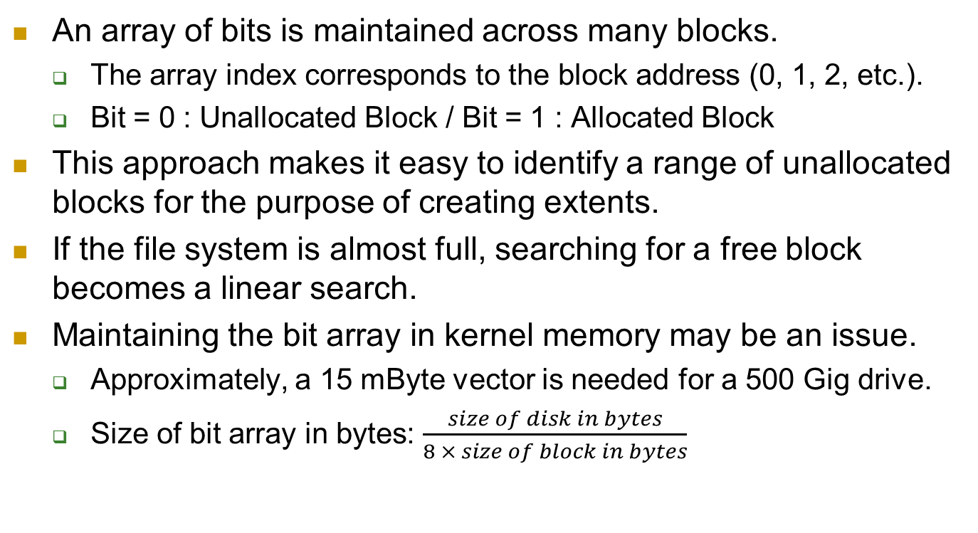
Bit Tables
An array of bits is maintained across many blocks.
The array index corresponds to the block address (0, 1, 2, etc.).
Bit = 0 : Unallocated Block / Bit = 1 : Allocated Block
This approach makes it easy to identify a range of unallocated blocks for the purpose of creating extents.
If the file system is almost full, searching for a free block becomes a linear search.
Maintaining the bit array in kernel memory may be an issue.
Approximately, a 15 mByte vector is needed for a 500 Gig drive.
Size of bit array in bytes: $\frac{size of disk in bytes}{8 × size of block in bytes}$
Notes:
Linux EXT4 uses bit tables to identify free blocks.

Slide 51
Chained Free Extents
Free space is managed in linked extents (segments) of contiguous unallocated blocks.
Free extents are chained together using a pointer to the next extent and the length of the extent.
Next Extent pointer and length of current extent are stored in the first block of each extent.
Low overhead required to maintain free list.
Lends itself to locating extents of contiguous blocks.
Can require significant overhead to maintain FB extents.
For example, freeing a block requires identifying the correct free list extent to attach it to.
Notes:
This method has its own problems. After some use, the disk will become quite fragmented and many extents will be a single block long. Also note that every time you allocate a block, you need to read the block first to recover the pointer to the new first free block before writing data to that block. If many individual blocks need to be allocated at one time for a file operation, this greatly slows file creation. Similarly, deleting highly fragmented files is very time consuming.

Slide 52
Free Block List
A list (data structure) of free block addresses is maintained in dedicated disk blocks.
Maintaining the list requires a relatively small amount of the overall drive capacity.
A small fraction of the list is maintained in memory.
The in-memory extents can be treated as a stack.
Allocated blocks are popped off the stack.
Returned blocks are pushed on the stack.
Unallocated blocks can be read from or written back to disk as needed.
Does not lend itself to maintaining extents of free blocks.
Notes:
It seems to me that this process suffers from an inability to manage free blocks in extents.

Slide 53
File System Consistency Checks
It would be too inefficient (slow) to write to disk every change made to a File System (FAT and UBL).
Instead FS information is cached in kernel memory and this cache periodically written to disk making the changes permanent.
If the system looses power, or otherwise crashes, the state of the FAT and UBL cached in memory is lost.
The state of the on-disk FAT and UBL data becomes inconsistent with the current file system state contained in kernel memory.
For example, a block may be removed from the UBL, but until this change to the UBL data structures is written to disk the state of the file system is open to corruption from a system crash.

Slide 54
File System Consistency Checks
One method of recovering from a crashed file system is to provide a consistency check utility that scans the entire file system identifying inconsistencies in the file system.
For example, blocks that are not attached to the FAT or UBL.
These utilities identify and repair inconsistencies to the File System data structures.
Often open files are corrupted by a crash and cannot be recovered at startup.
Older file systems make the execution of the consistency checks mandatory and substantially delay system startup.

Slide 55
Journaling File Systems
The Journaling File System is a method of more safely maintaining file system’s state.
A method of restoring the state of the File System in the event of a system crash with minimal FS corruption and data loss.
Updates to the FS’s state are recorded to disk in a Journal File.
The journal maintains entries that are appended over time.
A journal file entry records changes to the file system’s state and data e.g. block allocations to files, freed blocks, etc.
If the system crashes, all of the information needed to recover the file system is contained in the Journal File.
This makes file system recovery and system restarts very fast.

Slide 56
Journaling File Systems
For example, appending additional data to a file may involve three separate updates of:
The UBL to record an allocation of a block to the file.
The FAT to record the attachment of the new block to the file.
The file's inode, to note in the file's metadata that its size has increased.
Without Journaling, these three updates of the data structures would require at least three disk writes to record.
With Journaling, these three changes can be quickly recorded as the Journal File Entries.

Slide 57
The Journal File
Note: Only changes to the FAT and UBL data are recorded in the Journal.
Write operations that update a file’s data blocks are written directly to disk.
The OS provides a syscall that allows the process to force a flush of file changes to disk (see fflush())
Journal Entries are appended the Journal File.
Journal Entries are appended to a buffer in kernel memory and are flushed to disk when the buffer fills or every N milliseconds.
This way a single Journal File write operation may record dozens of changes to the FS (further reducing write operations).

Slide 58
System Startup Time
The Journal File is only needed with the system crashes and the correct state of the FS must be restored.
When the system is shutdown normally, it flushed the cached FAT and UBL data to disk before the FS is unmounted.
After a crash, on system startup the OS will “playback” the changes recorded in the Journal File.
The change recorded in each entry will be applied to the FAT and UBL data structures on disk before the FS is mounted.
Some power supplies can interrupt the processor / OS triggering a flush before the processor and drives loose power.

Slide 59
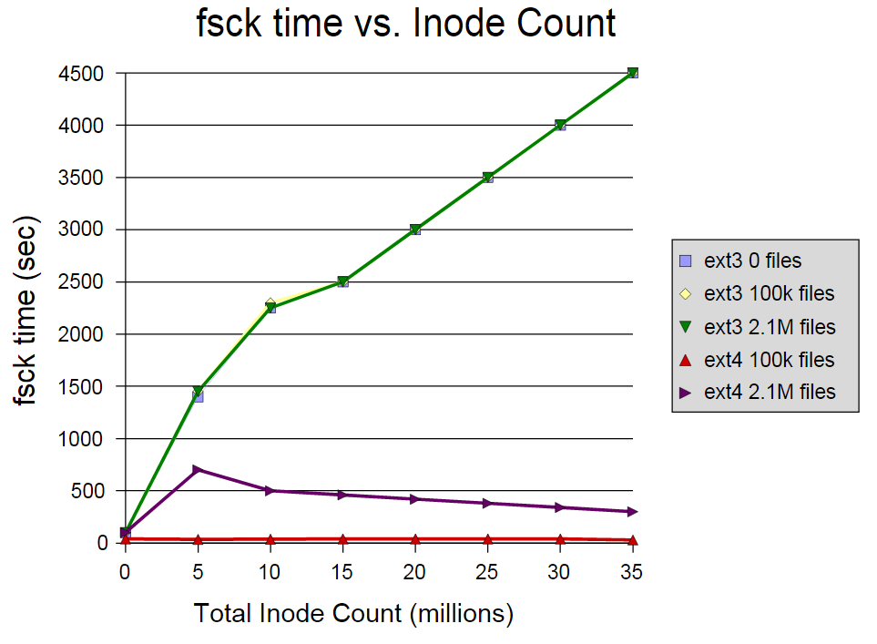
Effects of Journal File on System Startup Time
Notes:
This represents the time needed to check the file system (FSCK) without journaling (EXT3) and with a Journal file system (EXT4).

Slide 60
Volumes
A Volume describes one or more disk partitions that contain a single file system.
A Volume can be a means of combining one or more disk partitions into a single logical partition.
A Volume is a logical partition i.e. the OS see the a volume as a single partition with a start and end block (0-n).
A volume may span partitions from several physical disks.
Volumes are treated differently on various OS.
Windows: File systems must be created in a volume.
Linux: Volumes are optional and managed by a volume manager subsystem.

